Slide 1
ART410
One-Way Ride
A story driven 3D-Top-Down hybrid game prototype combining 3D top-down with multiple genres of play-styles.

Slide 2
AIM
A detailed analysis of methods to implement interactive game play around a pre-determined narrative by exploring the interplay between narrative and game design and the creation of “narrative puzzles” for a game prototype.
How can we design puzzles around key story events and give players enough freedom without making it a handheld experience?
Does a unique gameplay experience in each chapter of the story add to the novelty of the experience?
How can you alter player experience based on their prior interactions without changing the overarching narrative?
How to create a fail state for stories central to the gameplay?

Slide 3

DEVELOPMENT PROGRESS
I have implemented the following mechanics and have them working together.
Multiple levels of exploration
Gunplay
Crouching and cover
Intelligence and drunkenness
Ragdoll physics
I have to start working on the AI and start adding the story to use these mechanics.
We have to go on more asset hunting to make sure we get the required 3D models which fit our aesthetic and makes our game look more polished.

Slide 4
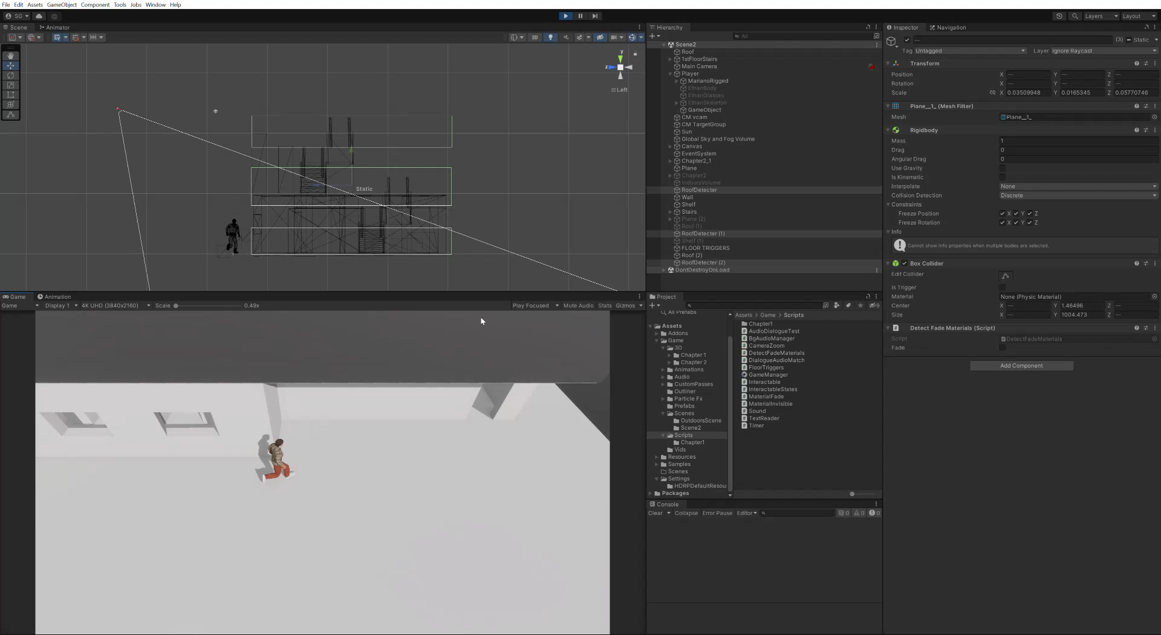
DEVELOPMENT PROGRESS
The multiple level fading system with each floor having its own trigger

Slide 5
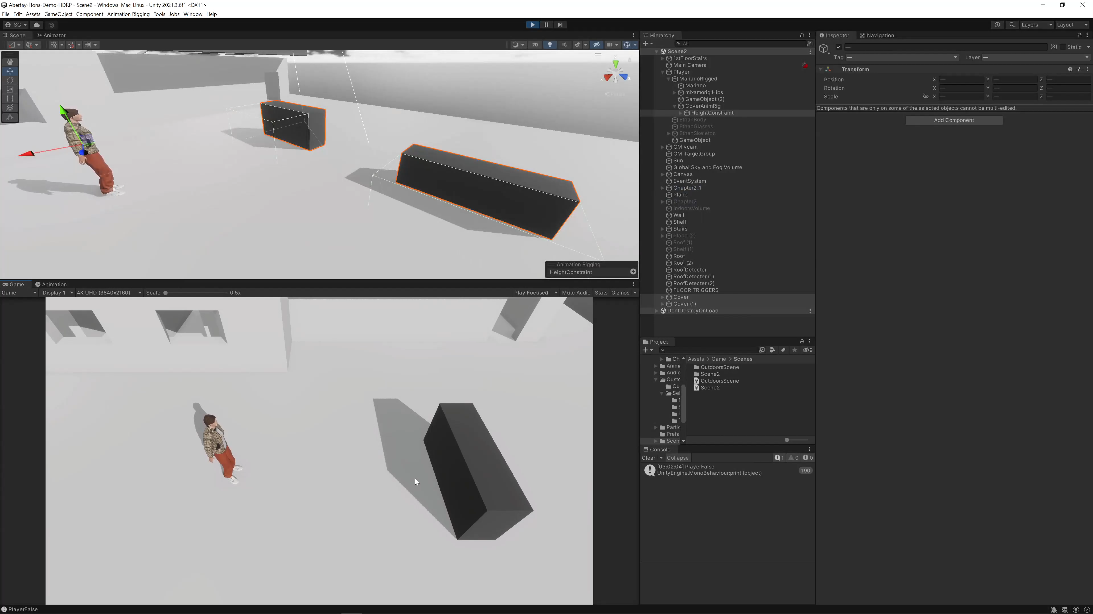
DEVELOPMENT PROGRESS
Dynamic crouching system between covers

Slide 6
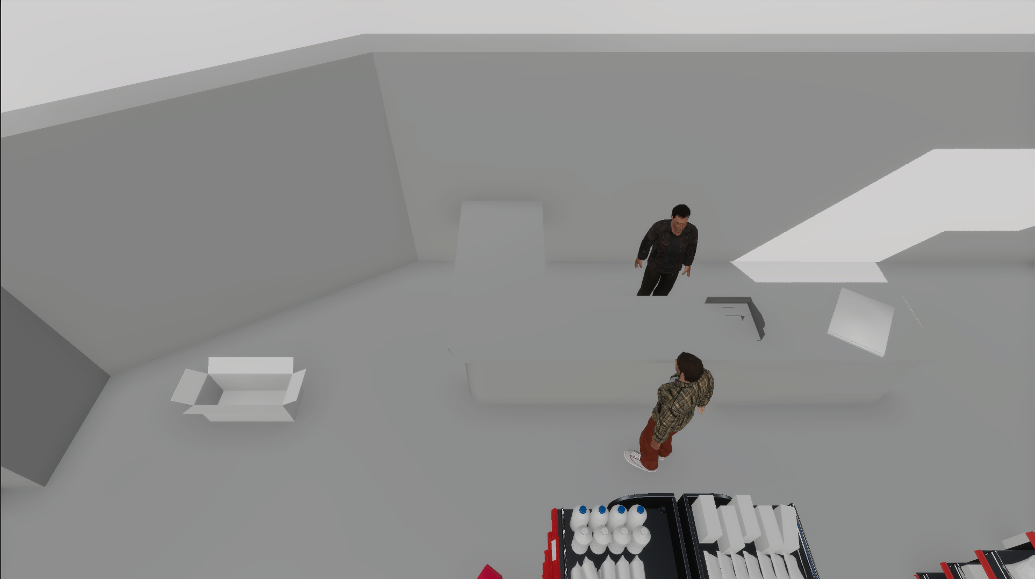
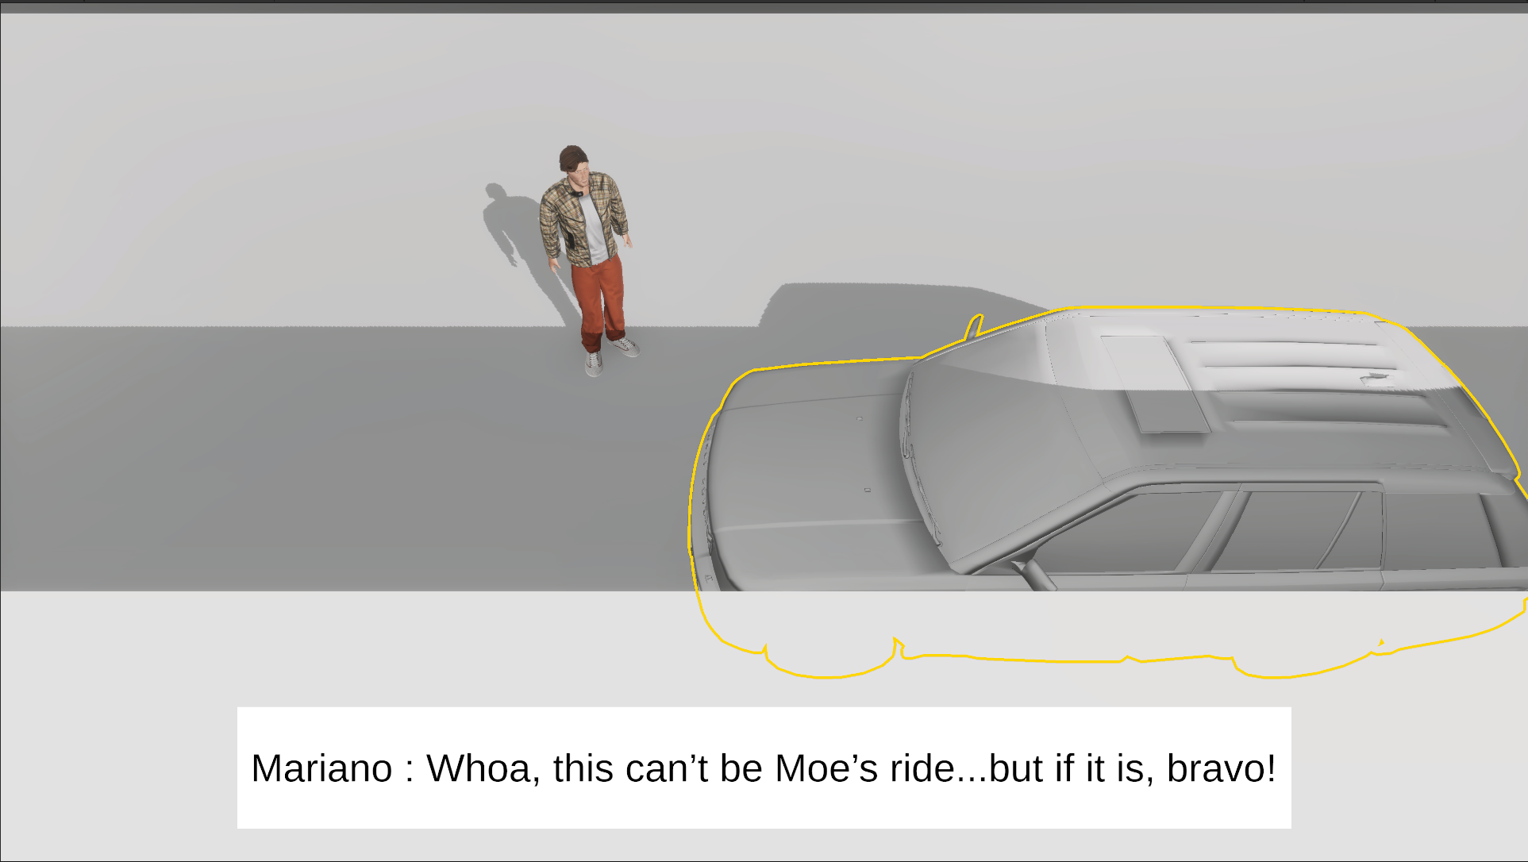
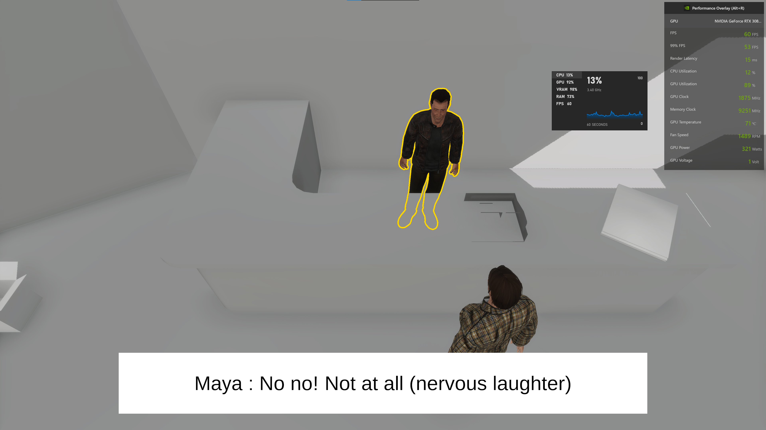
DEVELOPMENT PROGRESS
Intelligence Levels with the interaction system

Slide 7
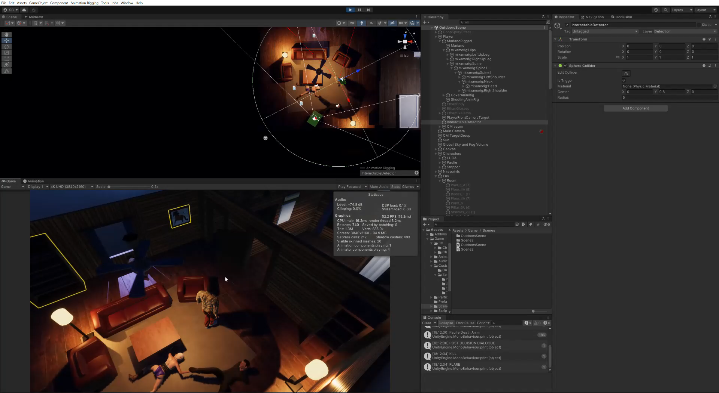
DEVELOPMENT PROGRESS
Experimenting with new camera features

Slide 8
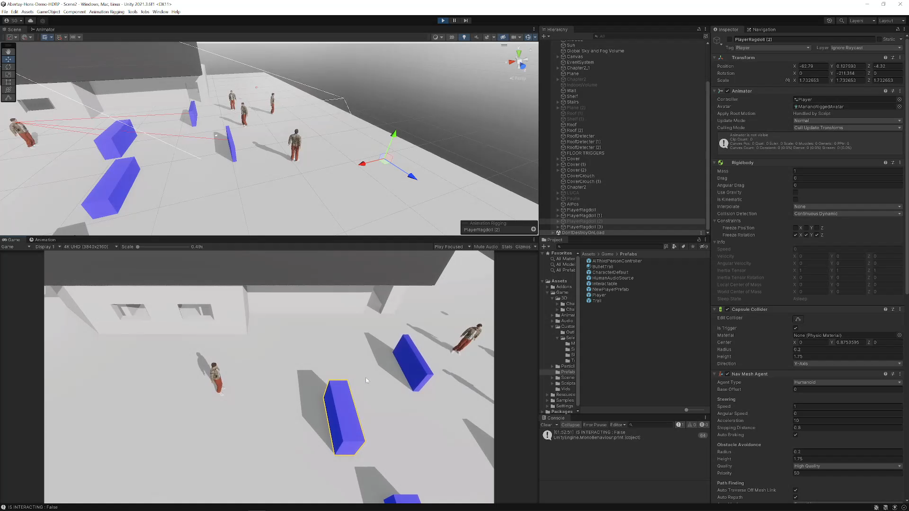
DEVELOPMENT PROGRESS
Ragdoll Physics

Slide 9
PROJECT REPORT
Learning Contract
Introduction
- Aim
- Research Questions
Research Context
Research Project
Conclusion
Introduction: I will start by introducing the project and explain how it is unique followed by the aim and research questions.
Research Context: The research done on the questions by stating mechanics in existing games, reading, and watching videos by existing professionals in the industry.
Research Project: I will continue to talk about how and why I implemented these ideas and how it aligns with my vision for the game by answering the research questions.

Slide 10
PROJECT PLAN
Since there hasn’t been a lot of progress on the environment, it feels like we are running behind. But most of the mechanics have already been implemented and I only need to get the AI working with them. It won’t be long before we start adding more story elements and implement the puzzles based on the story. So, it does seem like we’re on track.
The only main issue which I might face would be after finalizing the environment with performance issues. I’ve already performed a small experiment for this and tried using unity’s in-build occlusion culling system and the results were better performance. We will only find out later with the final assets and loading times.

